Slide 1
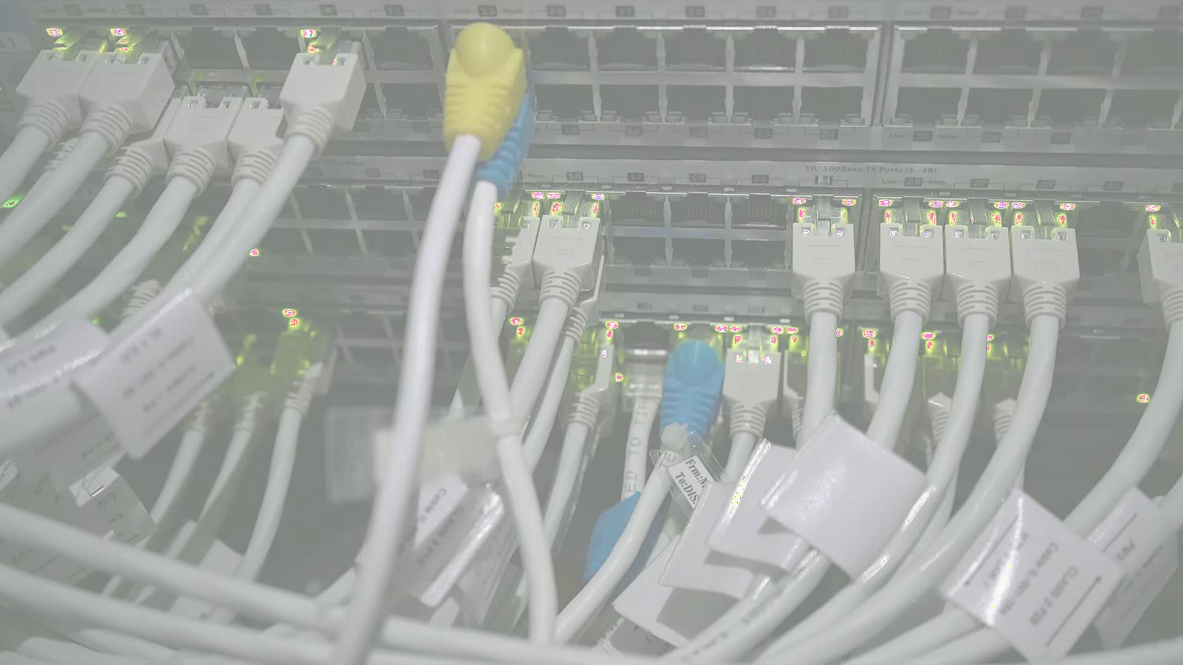
Computer Networks [Data Comm. And Basic Concepts]

Slide 2
Data Communications
When we communicate, we are sharing information. This sharing can be local or remote. Between individuals, local communication usually occurs face to face, while remote communication takes place over distance. The term telecommunication, which includes telephony, telegraphy, and television, means communication at a distance (tele is Greek for "far").
The word data refers to information presented in whatever form is agreed upon by the parties creating and using the data.

Slide 3
Data Communications
Data communications are the exchange of data between two devices via some form of transmission medium such as a wire cable.
For data communications to occur, the communicating devices must be part of a communication system made up of a combination of hardware (physical equipment) and software (programs).

Slide 4


Data Communication effectiveness Depends on
The system must deliver data to the correct destination. Data must be
Delivery.
received by the intended device or user and only by that device or user.
The system must deliver the data accurately. Data that have been altered
in transmission and left uncorrected are unusable.
Accuracy.
The system must deliver data in a timely manner. Data delivered late are useless.
In the case of video and audio, timely delivery means delivering data as they are produced, in the same order that they are produced, and without significant delay. This kind of delivery is called real-time transmission.
Timeliness.
Jitter refers to the variation in the packet arrival time. It is the uneven delay in the delivery of audio or video packets.
For example, let us assume that video packets are sent every 3D ms.
If some of the packets arrive with 3D-ms delay and others with 4D-ms
delay, an uneven quality in the video is the result.
Jitter.

Slide 5
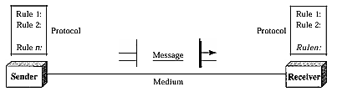
Components of Data Communication System

Slide 6



Components of Data Communication System
The message is the information (data) to be communicated. Popular forms of information include text, numbers, pictures, audio, and video.
Message
The sender is the device that sends the data message.
It can be a computer, workstation, telephone handset, video camera, and so on.
Sender
The receiver is the device that receives the message.
It can be a computer, workstation, telephone handset, television, and so on.
Receiver

Slide 7


Components of Data Communication System
The transmission medium is the physical path by which a message travels from sender to receiver.
Some examples of transmission media include twisted-pair wire, coaxial cable, fiber- optic cable, and radio waves.
Transmission
Medium
A protocol is a set of rules that govern data communications.
It represents an agreement between the communicating devices.
Without a protocol, two devices may be connected but not communicating, just as a person speaking French cannot be understood by a person who speaks only Japanese.
Protocol

Slide 8
Type of Connection
A network is two or more devices connected through links. A link is a communications pathway that transfers data from one device to another. For visualization purposes, it is simplest to imagine any link as a line drawn between two points.
For communication to occur, two devices must be connected in some way to the same link at the same time.
There are two possible types of connections:
point-to-point and multipoint.

Slide 9

Point-to-Point
A point-to-point connection provides a dedicated link between two devices.
The entire capacity of the link is reserved for transmission between those two devices.
Most point-to-point connections use an actual length of wire or cable to connect the two ends, but other options, such as microwave or satellite links, are also possible (see Figure a previous slide).
When you change television channels by infrared remote control, you are establishing a point-to-point connection between the remote control and the television's control system.

Slide 10
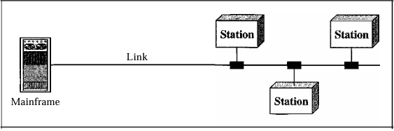
Multipoint
A multipoint (also called multidrop) connection is one in which more than two specific devices share a single link (see Figure above).
In a multipoint environment, the capacity of the channel is shared, either spatially or temporally.
If several devices can use the link simultaneously, it is a spatially shared connection.
If users must take turns, it is a timeshared connection.

Slide 11
Computer Network Architecture
Computer Network Architecture is defined as the physical and logical design of the software, hardware, protocols, and media of the transmission of data.
Simply we can say that how computers are organized and how tasks are allocated to the computer.

Slide 12


Peer to Peer
Types of Computer Network
Client/Server

Slide 13
Peer to Peer Network
Peer-To-Peer network is a network in which all the computers are linked together with equal privilege and responsibilities for processing the data.
Peer-To-Peer network is useful for small environments, usually up to 10 computers.
Peer-To-Peer network has no dedicated server.
Special permissions are assigned to each computer for sharing the resources, but this can lead to a problem if the computer with the resource is down.

Slide 14
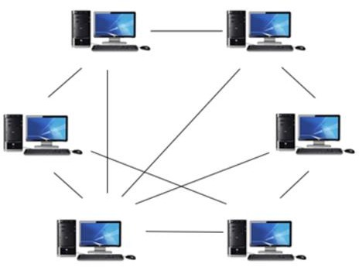
Peer to Peer Network

Slide 15
Peer to Peer Network
Advantages
It is less costly as it does not contain any dedicated server.
If one computer stops working but, other computers will not stop working.
It is easy to set up and maintain as each computer manages itself.
Disadvantages
In the case of Peer-To-Peer network, it does not contain the centralized system. Therefore, it cannot back up the data as the
data is different in different
locations.
It has a security issue as the device is managed itself.

Slide 16
Client/Server Network
Client/Server network is a network model designed for the end users called
clients, to access the resources such as songs, video, etc. from a central computer known as Server.
The central controller is known as a server while all other computers in the network are called clients.
A server performs all the major operations such as security and network management.
A server is responsible for managing all the resources such as files, directories, printer, etc.
All the clients communicate with each other through a server. For example,
if client1 wants to send some data to client 2, then it first sends the request
to the server for the permission. The server sends the response to the client 1 to initiate its communication with the client 2.

Slide 17
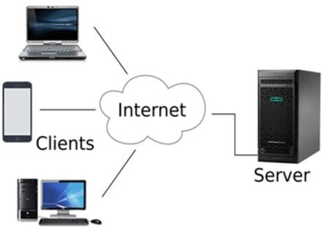
Client/Server Network

Slide 18
Client/Server Network
Advantages
A Client/Server network contains the centralized system. Therefore we can back up the data easily.
Disadvantages
Client/Server network is expensive as it requires the server with large memory.
A Client/Server
network has a
A server has a Network Operating
dedicated server that improves the overall performance of the whole system.
System(NOS) to provide the resources
to the clients, but the cost of NOS is
very high.
Security is
better in Client/Server • It
requires a dedicated network
all the
network as a single server administers the shared resources.
administrator to manage resources.
It also increases the speed of the
sharing resources.

Slide 19
Computer Network Components
Computer network components are the major parts which are
needed to install the software.
Some important network components are NIC, switch, cable, hub, router, and modem.
Depending on the type of network that we need to install, some network components can also be removed.
For example, the wireless network does not require a cable.

Slide 20
NIC
NIC stands for Network Interface Card.
NIC is a hardware component used to connect a computer with another computer onto a network
It can support a transfer rate of 10, 100 to 1000 Mb/s.
The MAC address or physical address is encoded on the network card chip which is assigned by the IEEE to identify a network card uniquely. The MAC address is stored in the PROM (Programmable read-only memory).

Slide 21




Types of NIC
The Wired NIC is present inside the motherboard. Cables and connectors are used with wired NIC to transfer data.
Wired NIC:
The wireless NIC contains the antenna to obtain the connection over the wireless network. For example, laptop computer contains the
wireless NIC.
Wireless NIC:

Slide 22
Hub
A Hub is a hardware device that divides the network connection among multiple devices.
When computer requests for some information from a network, it first sends the request to the Hub through cable.
Hub will broadcast this request to the entire network. All the devices will check whether the request belongs to them or not. If not, the request will be dropped.
The process used by the Hub consumes more bandwidth and limits the amount of communication.
Nowadays, the use of hub is obsolete, and it is replaced by more advanced computer network components such as Switches, Routers.

Slide 23
Switch
A switch is a hardware device that connects multiple devices on a computer network. A Switch contains more advanced features than Hub. The Switch contains the updated table that decides where the data is transmitted or not.
Switch delivers the message to the correct destination based on the physical address present in the incoming message.
A Switch does not broadcast the message to the entire network like the Hub. It determines the device to whom the message is to be transmitted. Therefore, we can say that switch provides a direct connection between the source and destination.
It increases the speed of the network.

Slide 24
Router
A router is a hardware device which is used to connect a LAN with an internet connection. It is used to receive, analyze and forward the incoming packets to another network.
A router works in a Layer 3 (Network layer) of the OSI Reference model.
A router forwards the packet based on the information available in the routing table.
It determines the best path from the available paths for the transmission of the packet.

Slide 25
Advantages of Router
Security:
The information which is transmitted to the network will traverse the entire cable, but the only specified device which has been addressed can read the data.
Reliability:
If the server has stopped functioning, the network goes down, but no other networks are affected that are served by the router.
Performance:
Router enhances the overall performance of the network. Suppose there are 24 workstations in a network generates a same amount of traffic. This increases the traffic load on the network. Router splits the single network into two networks of 12 workstations each, reduces the traffic load by half.
Network range

Slide 26
Modem
A modem is a hardware device that allows the computer to connect to the internet over the existing telephone line.
A modem is not integrated with the motherboard rather than it is installed on the PCI slot found on the motherboard.
It stands for Modulator/Demodulator. It converts the digital data into an analog signal over the telephone lines.
Based on the differences in speed and transmission rate, a modem can be classified in the following categories:
Standard PC modem or Dial-up modem
Cellular Modem
Cable modem

Slide 27
Cables and Connectors
Cable is a transmission media used for transmitting a signal.
There are three types of cables used in transmission:
Twisted pair cable
Coaxial cable
Fibre-optic cable

